Slide 1
Outcome Based Education
Fazal Abbas - 09162013013
Muhammad Afraz - 09162013004

Slide 2
Agenda
01. Problem Description
02. Purposed Solution
03. Modules
04. Requirement Analysis
05. Design and Architecture
06. Conclusion
07. Project Demo

Slide 3
01. Traditional Education System
Provides students with a learning environment with little attention to whether or not students ever learn the material.
A focus on rote memorization rather than understanding and critical thinking.
Graduates are not completely prepared for the workforce.
A lack of opportunities for students to engage in hands-on, experiential learning.

Slide 4
02. Proposed Solution Traditional System vs OBE - Curriculum Design
Traditional System
Rigid, standardized curriculum that may not meet the diverse needs and interests of students.
A focus on memorization and rote learning rather than critical thinking and problem-solving.
Lack of flexibility for teachers to incorporate their own teaching styles and local context.
Inadequate attention to developing 21st-century skills, such as communication, collaboration, and critical thinking.

Slide 5
02. Proposed Solution Traditional System vs OBE - Curriculum Design
OBE
A focus on student learning outcomes and competencies, rather than just the coverage of content.
An emphasis on student-centered, personalized learning experiences that meet the individual needs and interests of students.
Greater flexibility for teachers to adapt the curriculum to their own teaching styles and local context.
An increased emphasis on developing 21st-century skills and real-world competencies, such as communication, collaboration, and critical thinking.

Slide 6
Modules
Login Module
Faculty Module
Curriculum Module
Assessment Module
Attainments Module

Slide 7
2.1 Login Module
User authentication: The login module verifies the user's identity by checking the provided credentials against the information stored in the system's database.
Secure password storage: The login module stores user passwords in an encrypted format to ensure the security of users' personal information.
Session management: The login module starts a new session for the user once they have successfully logged in, allowing them to access the system's features and functions.
Logout feature: The login module also includes a logout feature that allows users to end their session and log out of the system.

Slide 8
2.2 Faculty Module
The Modules’ main features includes:
Add faculty: User will be able to add faculty.
Update Faculty: User will be able to Update existing record of faculty
Delete Faculty: User will be able to Delete existing record of faculty.
View Faculty: User will be able to View existing record of faculty.

Slide 9
2.3 Curriculum Module
The Modules’ main features includes:
Batches: User will be able to Create, update, and delete Batches
Terms: User will be able to Create, update, and delete Terms
Courses: User will be able to Create, update, and delete Courses and add course outcome (CO)
Course Outcome: Add CO providing relevant information in form regarding course also update, delete and view CO
CO mapping with PO: User will map CO with PO and save the map.

Slide 10
2.4 Assessment Module
The Modules’ main features includes:
Direct Assessment: user will add assessment by selecting the appropriate curriculum, term and course. The assessment will be updated and deleted and will be viewed by user.

Slide 11
2.5 Attainments
Data Import: The user may download templates, import data, and examine assessment results by choosing the proper curriculum, term, and course.
CO Attainment: By choosing relevant curriculum, term, and course the use will calculate the CO attainment by setting the maximum or minimum threshold value.

Slide 12
Requirement Analysis

Slide 13
FR-1
Identifier | FR-1
Title | User Authentication
Requirement | From User Perspective: The User shall be able to login to the system using a valid username and password. The login process should be quick and secure, and the user should be able to access the system within 5 seconds of entering the correct login credentials. From System Perspective: Upon receipt of a login request from the user, the system shall verify the user's username and password against the database. If the login credentials are valid, the system shall allow the user to access the system and display the user's homepage. If the login credentials are invalid, the system shall display an error message indicating that the login has failed and prompt the user to try again.

Slide 14
FR-2
Identifier | FR-2
Title | Add Faculty
Requirement | User Perspective: The admin shall be able to add new faculty members to the system by providing their personal and professional information such as name, email, designation, and department. The faculty member's information should be added within 2 minutes with high accuracy. System Perspective: Upon the trigger of the "Add Faculty" feature, the system shall collect the required information from the admin, validate the entered data, and store it in the database. The system shall display a confirmation message after successfully adding the faculty member's information to the database. In case of any invalid data, the system shall prompt an error message to the Admin for correction.

Slide 15
FR-3
Identifier | FR-3
Title | Add Curriculum
Requirement | From user perspective: The administrator shall be able to add a new curriculum/ add course or CO to the system by providing the necessary information such as the curriculum name, description, and subject areas. From system perspective: Upon receiving a request to add a curriculum / add course or CO, the system shall validate the input data, store the information in the database, and display a success message to the administrator.

Slide 16
FR-4
Identifier | FR-4
Title | Add Assessment
Requirement | User perspective: The administrator shall be able to add assessments to specific courses with the required details such as type, weightage, and Questions and its relevant CO. System perspective: On the trigger event of the administrator requesting to add an assessment, the system shall validate the course information and collect the assessment details. The system shall then store the assessment information in the database and display a confirmation message to the administrator.

Slide 17
FR-5
Identifier | FR-5
Title | Check Attainments
Requirement | User perspective: The user shall be able to check the attainments of students for a specific assessment also check attainment of CO over PEO [qualifying conditions, response time, or quality statement]. System perspective: Upon the request of the user, the system shall provide the attainments of students for a specific assessment and CO attainment over PEO [expected system response].

Slide 18
Design and Architecture

Slide 19
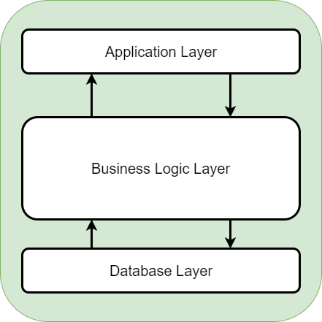
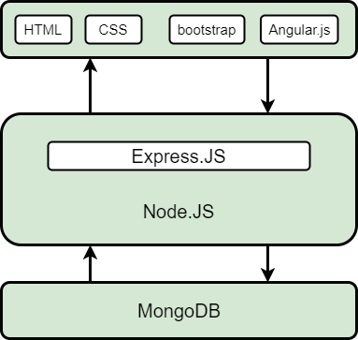
Architecture

Slide 20
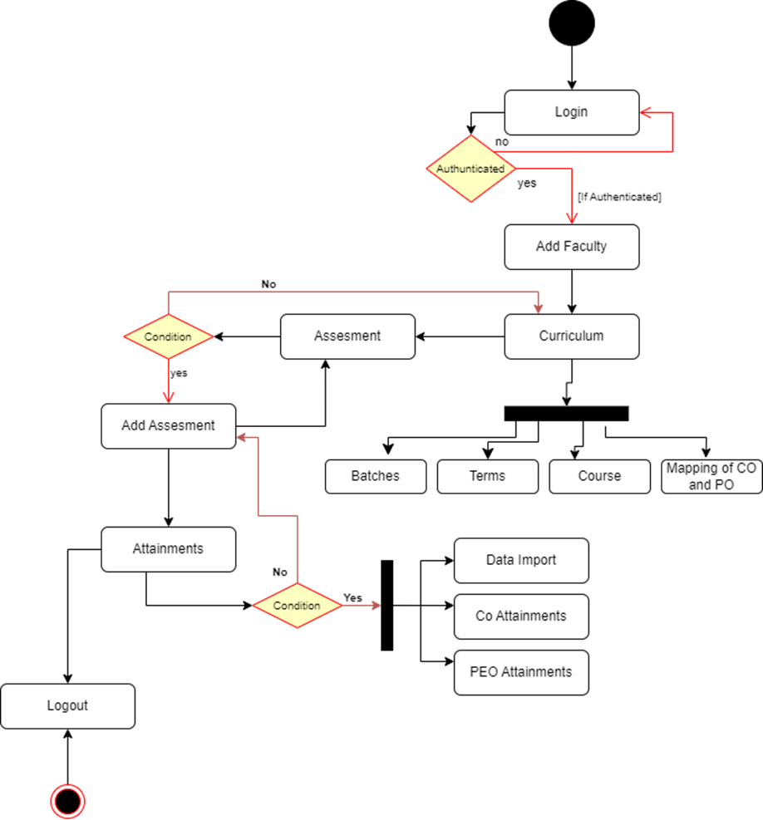
Activity Diagram

Slide 21
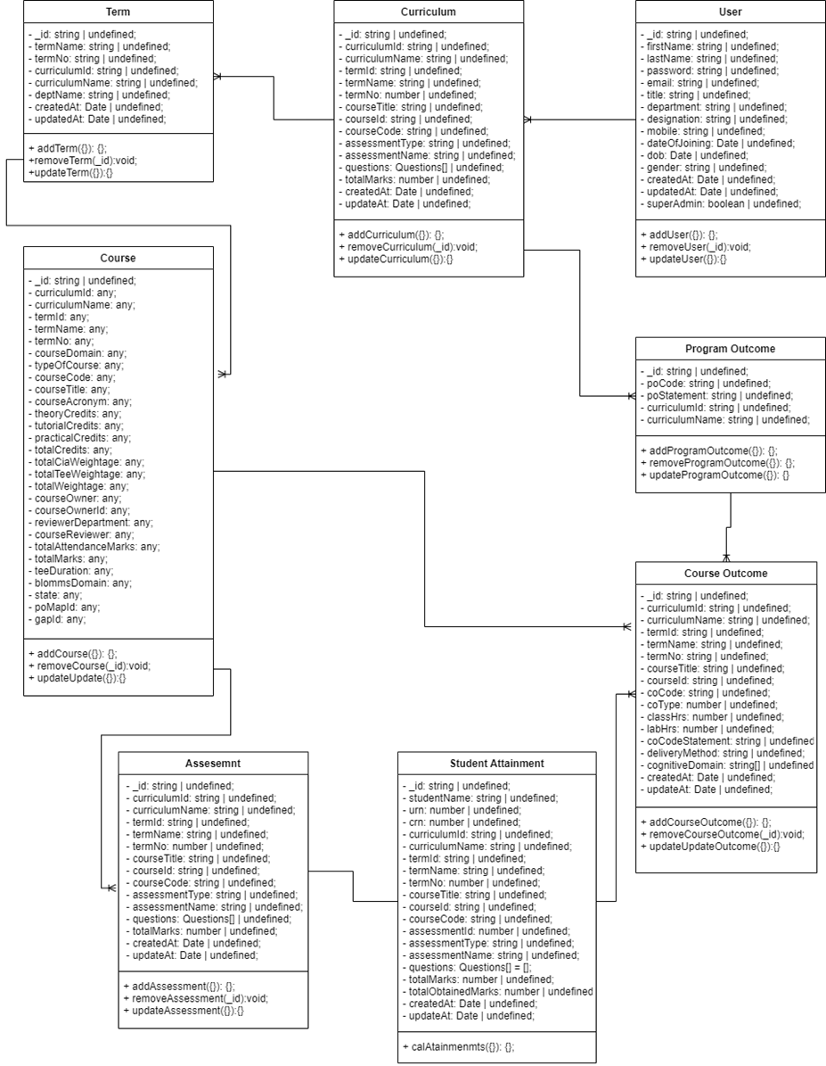
Class Diagram

Slide 22
Conclusion

Slide 23
The Outcome Based Education web application is designed for education institutions to manage curriculums, assessments, and outcomes
It has a 3-tier architecture designed for scalability, security, and reliability
Utilizes modern technologies such as MERN Stack and MongoDB
Focus on user experience, with various features such as adding and managing assessments, viewing student performance, and tracking progress of student outcomes
Extensive testing has been conducted to ensure the application meets requirements
Data management is efficiently handled using MongoDB
Provides a comprehensive and user-friendly solution for teachers.

Slide 24

Thank you

